Slide 1
College Algebra
Acosta/Karwowski

Slide 2
Unit 5

Slide 3
Chapter 5 – section 3
Inverses defined by compositions

Slide 4
Definition
f(x) and g(x) are inverses if and only if:
1. the domain of f is the same as the range of g
2. the range of “f” is the same as the domain of “g”
3. (f∘g)(x) =(g∘f)(x) = x
Since we can always make the domain and range match by restricting ourselves to a stated domain we are concerned with # 3 primarily
note: (f⁻¹ ∘ f)(x) =x for ALL numbers

Slide 5
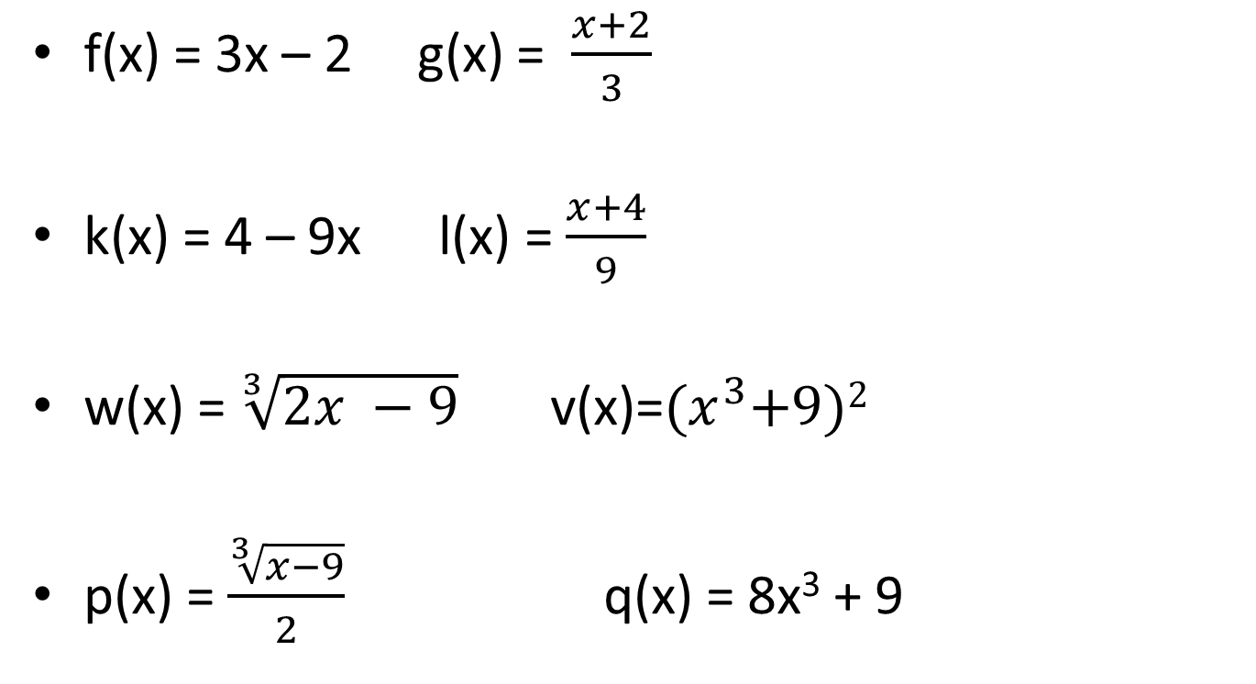
Prove that the functions are inverses:
f(x) = 3x – 2 g(x) = $\frac{x+2}{3}$
k(x) = 4 – 9x l(x) = $\frac{x+4}{9}$
w(x) = $\sqrt[3]{2x −9}$ v(x)=${(x}^{3}+9)2$
p(x) = $\frac{\sqrt[3]{x−9}}{2}$ q(x) = 8x³ + 9

Slide 6
Chapter 6 – Section 1
Exponential functions

Slide 7
Definition
f(x) is an exponential function if it is of the form f(x) = b^{x} and b> 0
Which of the following are exponential functions

Slide 8
Analyzing the function – (graph)
domain?
Range ?
Y – intercept?
x-intercept?

Slide 9
Transformation of an exponential function
f(x) = P(b^{ax + c}) + d
P changes the y – intercept but not the asymptote
d changes the horizontal asymptote and the intercept
a can be absorbed into b and just makes the graph steeper
c can be absorbed into P and changes the y – intercept
Ex: f(x) = 3 (2^{2x-5}) – 5
Essentially any base

Slide 10
Linear vs exponential
mx vs b^{x}
repeated addition vs repeated multiplication
increasing vs decreasing
m> 0 increasing b>1 f(x) is increasing
m<0 decreasing b< 1 f(x) is decreasing
Watch out for transformation notations
f(x) = (0.5)^{-x} is an increasing function

Slide 11
Writing exponential functions
When the scale factor is stated:
ex: a population starts at 1 and triples every month
ex: 20 ounces of an element has a half-life of 6 months
Rates of increase or decrease
ex. A bank account has $400 and earns 3% each year
ex: A $80 thousand car decreases in value by 5% each year

Slide 12
Finding b for an exponential function
f(x) = P(b^{x})
Given the value of P and one other point determine the value of b
Given (0,3) and (2,75)
since f(x) = P (b^{x}) f(0) = P(b⁰) = P
so f(x) = 3b^{x}
Now f(2) = 3b² = 75
therefore b = ± 5 but b >0 so b = 5
Thus f(x) = 3(5^{x})

Slide 13
Examples: use graph or table to select the y-intercept and one point
(0,2.5) and (3, 33.487)
g(x) = 2.5(b^{x})
g(x) = 2.5(2.37^{x})
(0,500) (7, 155) f(x) = 500(0.846^{x})

Slide 14
Assignment
P483 (1-61) odd

Slide 15
Chapter 6 - section 2
Logarithms

Slide 16
Inverse of an exponential graph
f(x ) = 3^{x} is a one to one graph
Therefore there exist f⁻¹(x) which is a function with the following known characteristics
Since domain of f(x) is ________________
then ___________ of f⁻¹(x) is _______
Since range of f(x) is ________________
then ___________ of f⁻¹(x) is ________
since f(x) has a horizontal asymptote
f⁻¹(x) has a _____asymptote
Since y- intercept of f(x) is ____________
then x – intercept of f⁻¹(x) is ______
Since x intercept of f(x) is __________
then y – intercept of f⁻¹(x) is ________

Slide 17
We know the graphs look like
f(x)
f⁻¹(x)

Slide 18
We know that
f⁻¹(f(x) ) = f⁻¹(3^{x}) = x
f(f⁻¹(x) ) = 3 ^{f-1(x)} = x

Slide 19
What we don’t have
is operators that will give us this
So we NAME the function – it is named
log₃(x)

Slide 20
Transformations on log Graphs
graph log₂(x – 5) = y
Graph - log₅(x)= y
Graph log (-x + 2) = y

Slide 21
notation
log_{b}(x) = y
then x is a POWER(root) of b with an exponent of y
Understanding the notation

Slide 22
Examples- write the inverse statement
Write 36 = 6² as a log statement
write y = 10^{x} as a log statement
write log₄(21) = z as an exponential statement
write log₃(x+2) = y as an exponential statement

Slide 23
Using log to write inverse functions
f(x) = 5^{x} then f⁻¹(x) = log₅(x)
work: given y = 5^{x}
exchange x and y x = 5^{y}
write in log form log₅(x) = y
NOTE: log is NOT an operator . It is the NAME of the function.

Slide 24
Basic properties of ALL logarithms
The following are true for all log functions.
log_{b}(1) = 0
log_{b}(b) = 1
log_{b}(b^{x}) = x recall f⁻¹(f(x) ) = f⁻¹(3^{x}) = x
b^{(logb(x))} = x recall f(f⁻¹(x) ) = 3 ^{f-1(x)} = x

Slide 25
Evaluating simple rational logs
Evaluate the following
log₂(32) log₃(9) log₃(3^{2/3}) log₃₆(6)
log₅(5^{2.2}) log₃(1)

Slide 26
Evaluating irrational logs
log₁₀(x) is called the common log and is programmed into the calculator
it is almost always written log(x) without the subscript of 10
log(100) = 2
log(90) is irrational and is estimated using the calculator

Slide 27
Examples
log₅(5^{2.2}) =
log₃(1) =

Slide 28
Chapter 6 – section 3
Base e and the natural log

Slide 29
The number e
There exists an irrational number called e that is a convenient and useful base when dealing with exponential functions – it is called the natural base
ALL exponential functions can be written with base e
y = e^{x} is often called THE exponential function
log_{e}(x) is called the natural log and is notated as ln(x)
Your calculator has a ln / e^{x} key with which to estimate power of e and ln(x)

Slide 30
Estimate these irrational numbers
e⁵ ln(7) 16 + ln(2.98) e^{(-2/5)}

Slide 31
Use properties to evaluate
ln (e)
e^{ln(2)}
ln(e^{5.98})
log₇(1)

Slide 32
Changing bases
Given y = 3^{x} write the exponential base e that is approximately equivalent to this equation
I want 3 = eª
rewriting as a log statement ln(3) = a Using the calculator I find ln(3)≈ 1.1
there for e^{1.1}≈ 3
and y = (e^{1.1})^{x} = e ^{1.1x}

Slide 33
Assignment
p 524(1-18) all
(20-34)odd – graph WITHOUT calculator using transformation theory

Slide 34
Chapter 6 – section 4
Solving equations

Slide 35
Laws of logarithms
log is not an operator – it does not commute, associate or distribute
log(x+2) ≠ log(x) + log (2)
log(x + 2) ≠ log(x) + 2
log(5/7) ≠ log(5)/ log(7)
directly based on laws of exponents
log(MN) = log(M) + log(N)
log(M/N) = log(M) – log(N)
log(Mª) = alog(M)

Slide 36

Applying the laws to expand a log
log(5x)
log($2 \sqrt[3]{x}$)
log(x+ 5)
$ln⁡\left(\frac{e^{5}}{x}\right)$
$log⁡\left(\frac{\sqrt{2x}}{{3x}^{5}}\right)$

Slide 37

Applying laws to condense a log
log(x) - 3log(5) + log(4)
5(log(2)+ log(x))
$\frac{2}{3}ln⁡($x) + ln(5) – (ln(2)+ln(x+3))

Slide 38
Evaluating irrational logs other than common and natural logs
evaluate log_{b}(x)
Rationale b^{y} = x implies y = log_{b}(x)
rewrite b^{y} = x also implies
log(b^{y}) = log(x)
y(log(b)) = log(x)
$y=\frac{log⁡(x)}{log⁡(b)}$
thus $\log_{b}\left(x\right)=\frac{log⁡(x)}{log⁡(b)}$
called change of base formula

Slide 39

Solving exponential equations
Basic premise if a = b then log(a) = log(b)
if a^{x} = a^{y} then x = y
3^{x} = 3^{2x - 7}
16^{x} = $\sqrt{2}$
28 = 5^{x}
7^{x+2} = 15
5 + 2^{x} = 13

Slide 40

Use change of base formula
$\log_{b}\left(x\right)=\frac{log⁡(x)}{log⁡(b)}$
Find log₃(15)

Slide 41
Solving logarithm equations
Condense into a single logarithm
move constants to one side.
Rewrite as an exponential statement
Solve the resulting equation

Slide 42
Non – linear systems

Slide 43
Systems of quadratics
With linear - 3 possibilities
Two quadratics

Slide 44
Systems involving quadratics
Solving by substitution. Write one equation using x and solve
Example y = x² + 2x – 11
y = 24 + 4x
Example: y = 3x² + 8x – 9
y + 3x² = x - 11

Slide 45
Addition method
You can only use if one of the variables only exists as like terms.
Examples:
x² + y² = 13
(x – 4)²+ 2y² = 9

Slide 46
Example
log₂(x – 3) = 5
log(x-2) + log(x+ 4) = 1
5 + log₃(3x) – log₃(x + 2) = 3

